Slide 1
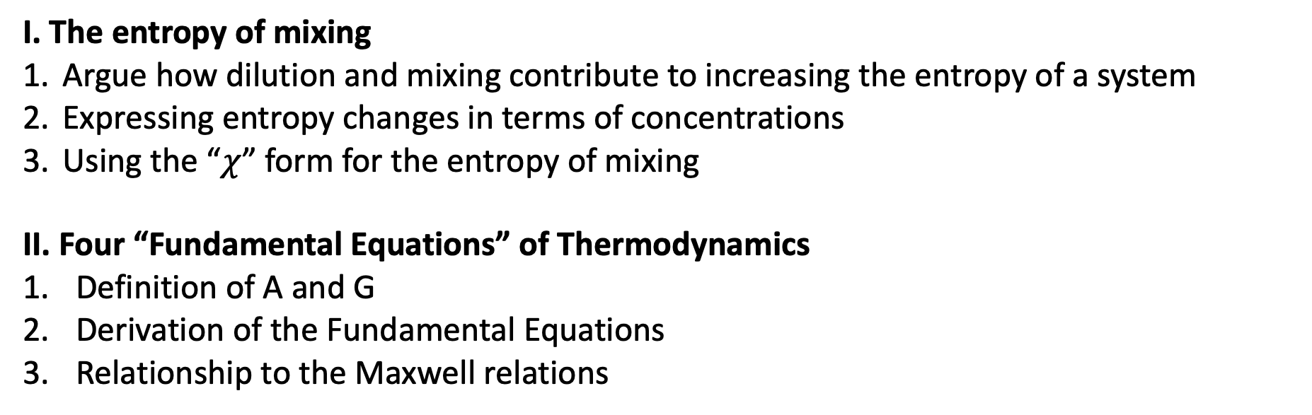
Goals for today
I. The entropy of mixing
Argue how dilution and mixing contribute to increasing the entropy of a system
Expressing entropy changes in terms of concentrations
Using the “$χ$” form for the entropy of mixing
II. Four “Fundamental Equations” of Thermodynamics
Definition of A and G
Derivation of the Fundamental Equations
Relationship to the Maxwell relations

Slide 2
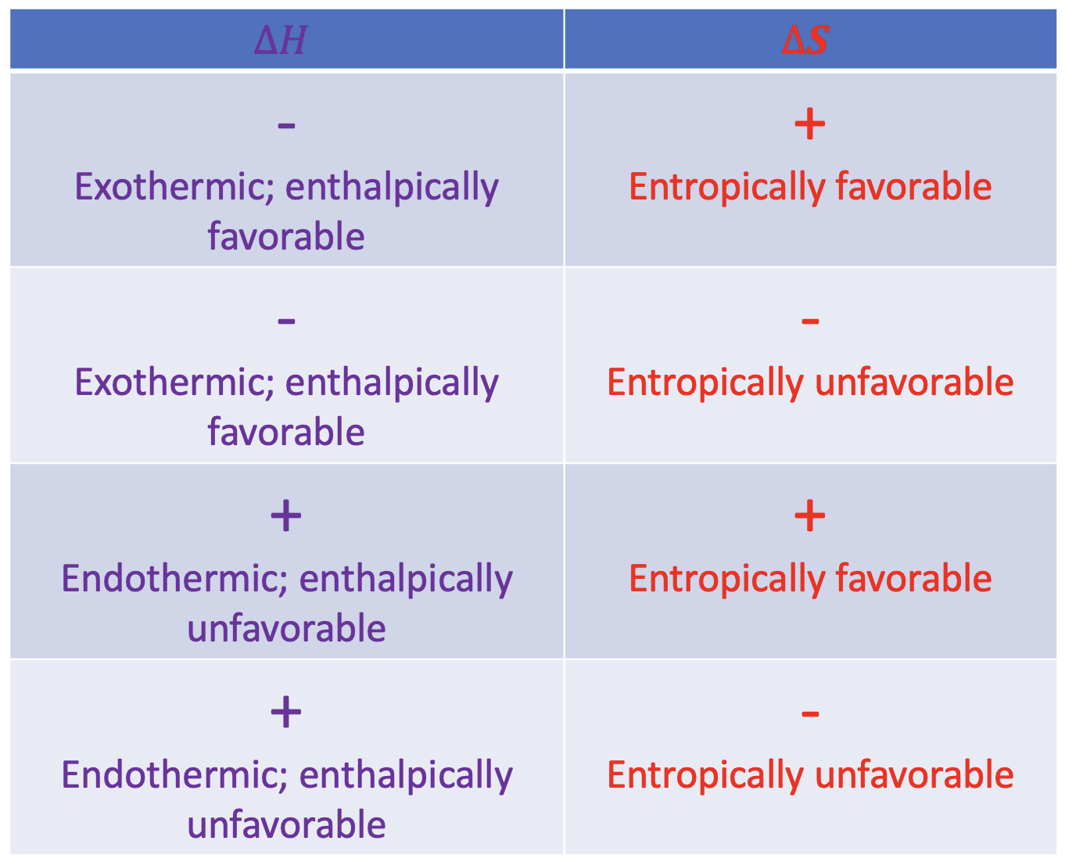
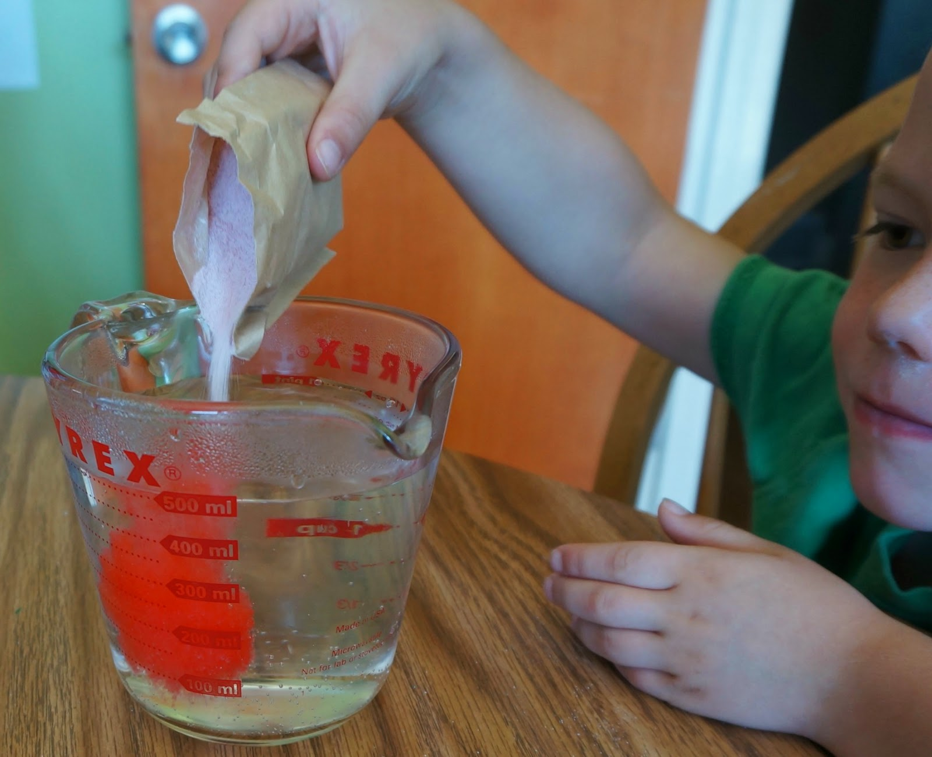
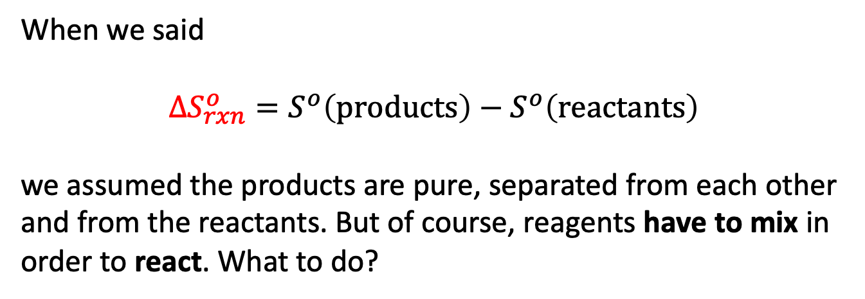
I. The entropy of mixing
Remember we talked about irreversibility? Irreversibility happens whenever we mix different chemical substances.
When we said
$$∆S_{rxn}^{o}=S^{o}\left(products\right)−S^{o}\left(reactants\right)$$
we assumed the products are pure, separated from each other and from the reactants. But of course, reagents have to mix in order to react. What to do?
$H_{2}$
$H_{2}$
$H_{2}$
$H_{2}$
$$HF$$
$$F_{2}$$
$$F_{2}$$
$H_{2}$
$$HF$$
$$F_{2}$$
$$F_{2}$$
$$F_{2}$$
$$F_{2}$$

Slide 3
Recap of the 2nd Law
$∆S_{tot}=∆S+∆S_{surr}>0$ for all spontaneous processes. This is the 2nd Law
All about entropy changes of the surroundings due to heat going in/out

Slide 4
Recap of the 2nd Law
$∆S_{tot}=∆S+∆S_{surr}>0$ for all spontaneous processes. This is the 2nd Law
All about entropy changes of the surroundings due to heat going in/out
Before, we said this was all about physical changes (boiling, melting) and chemical transformations (reactions).
Now, we’re saying that it’s also about mixing.

Slide 5
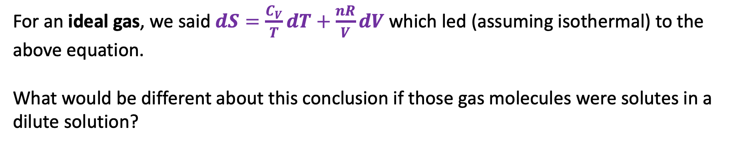

$$∆S=nRln\left(\frac{V_{f}}{V_{i}}\right)$$
Taking a lesson from gases
For an ideal gas, we said $dS=\frac{C_{V}}{T}dT+\frac{nR}{V}dV$ which led (assuming isothermal) to the above equation.
What would be different about this conclusion if those gas molecules were solutes in a dilute solution?

Slide 6

$$∆S_{dil}=nRln\left(\frac{V_{f}}{V_{i}}\right)$$
Entropy of dilution
For an ideal solute, we’ll say the same thing! (Still assuming isothermal). We’ll call this the entropy of dilution, $∆S_{dil}$.

Slide 7
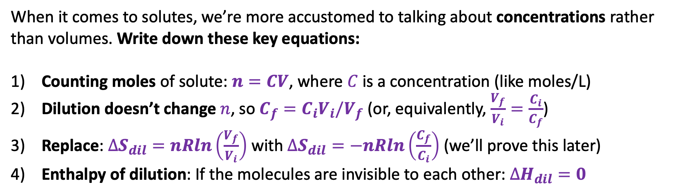
$$∆S_{dil}=nRln\left(\frac{V_{f}}{V_{i}}\right)$$
Entropy of dilution
When it comes to solutes, we’re more accustomed to talking about concentrations rather than volumes. Write down these key equations:
Counting moles of solute: $n=CV$, where $C$ is a concentration (like moles/L)
Dilution doesn’t change $n$, so $C_{f}={C_{i}V}_{i}/V_{f}$ (or, equivalently, $\frac{V_{f}}{V_{i}}=\frac{C_{i}}{C_{f}}$)
Replace: $∆S_{dil}=nRln\left(\frac{V_{f}}{V_{i}}\right)$ with $∆S_{dil}=−nRln\left(\frac{C_{f}}{C_{i}}\right)$ (we’ll prove this later)
Enthalpy of dilution: If the molecules are invisible to each other: $∆H_{dil}=0$

Slide 8
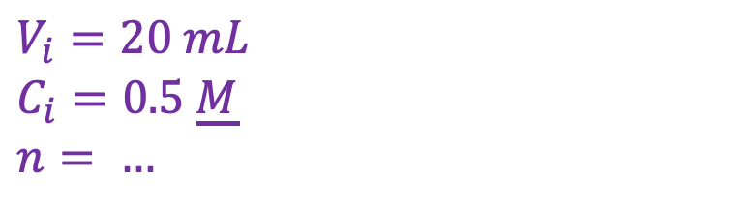
Examples (CGI) …
$$V_{i}=20 mL$$
$$C_{i}=0.5 \underline{M}$$
$$n= …$$

Slide 9
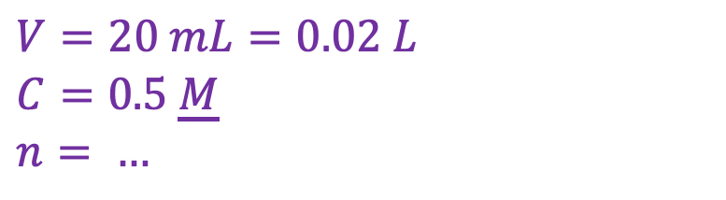
Examples (CGI) …
$$V=20 mL=0.02 L$$
$$C=0.5 \underline{M}$$
$$n= …$$

Slide 10
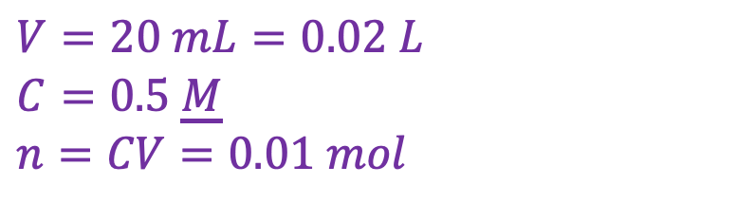
Examples (CGI) …
$$V=20 mL=0.02 L$$
$$C=0.5 \underline{M}$$
$$n=CV=0.01 mol$$

Slide 11
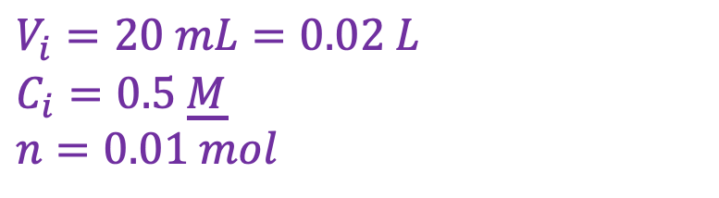
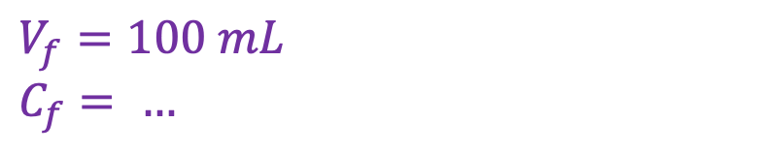
Examples (CGI) …
$$V_{i}=20 mL=0.02 L$$
$$C_{i}=0.5 \underline{M}$$
$$n=0.01 mol$$
$$V_{f}=100 mL$$
$$C_{f}= …$$

Slide 12
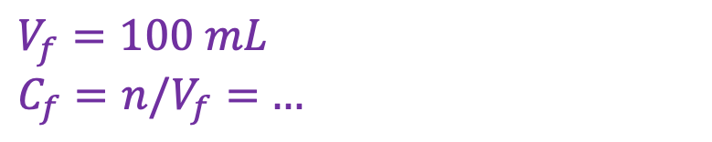
Examples (CGI) …
$$V_{i}=20 mL=0.02 L$$
$$C_{i}=0.5 \underline{M}$$
$$n=0.01 mol$$
$$V_{f}=100 mL$$
$C_{f}=n/V_{f}=$ $…$

Slide 13
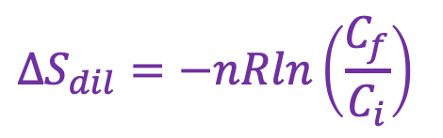
Examples (CGI) …
$$V_{i}=20 mL=0.02 L$$
$$C_{i}=0.5 \underline{M}$$
$$n=0.01 mol$$
$$V_{f}=100 mL$$
$C_{f}=n/V_{f}=$ $…$
$$∆S_{dil}=−nRln\left(\frac{C_{f}}{C_{i}}\right)$$

Slide 14
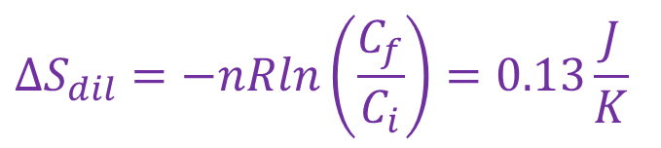
Examples (CGI) …
$$V_{i}=20 mL=0.02 L$$
$$C_{i}=0.5 \underline{M}$$
$$n=0.01 mol$$
$$V_{f}=100 mL$$
$C_{f}=n/V_{f}=$ $…$
$$∆S_{dil}=−nRln\left(\frac{C_{f}}{C_{i}}\right)=0.13\frac{J}{K}$$

Slide 15
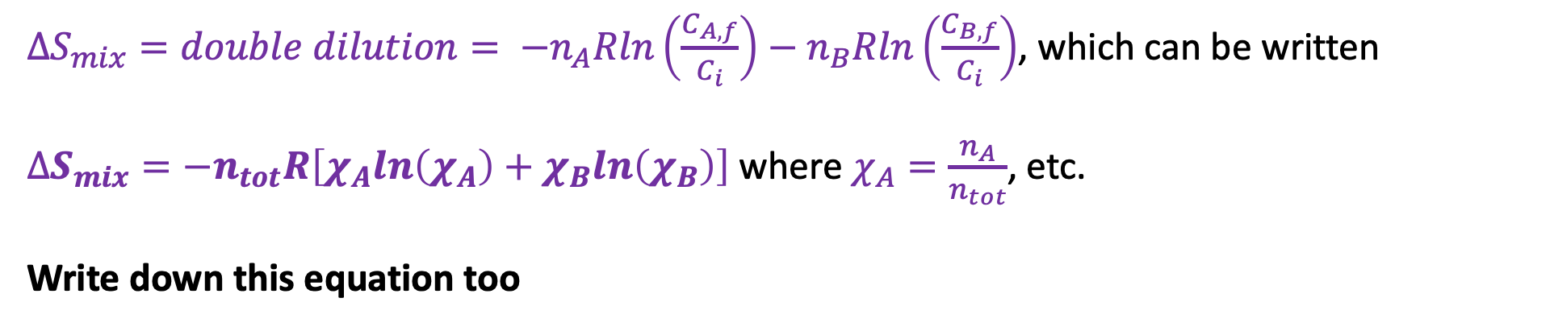

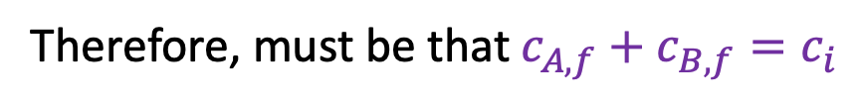



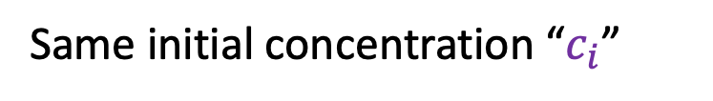
Entropy of mixing
$$n_{A}$$
$$c_{B,f}$$
$$n_{B}$$
$$c_{A,f}$$
Same initial concentration “$c_{i}$”
Therefore, must be that $c_{A,f}+c_{B,f}=c_{i}$
$∆S_{mix}=double dilution= −n_{A}Rln\left(\frac{C_{A,f}}{C_{i}}\right)−n_{B}Rln\left(\frac{C_{B,f}}{C_{i}}\right)$, which can be written
$∆S_{mix}=−n_{tot}R\left[χ_{A}ln\left(χ_{A}\right)+χ_{B}ln\left(χ_{B}\right)\right]$ where $χ_{A}=\frac{n_{A}}{n_{tot}}$, etc.
Write down this equation too

Slide 16
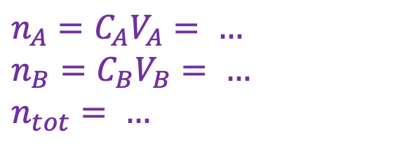
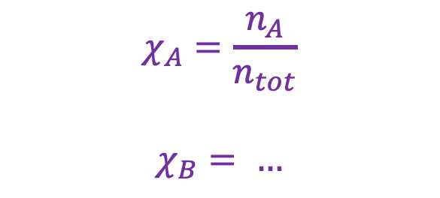
Example (CGI)
$$∆S_{mix}=−n_{tot}R\left[χ_{A}ln\left(χ_{A}\right)+χ_{B}ln\left(χ_{B}\right)\right]$$
10 mL of A and 20 mL of B
(both 1 M solutions)
$$χ_{A}=\frac{n_{A}}{n_{tot}}$$
$$χ_{B}= …$$
Let mix
$$n_{A}=C_{A}V_{A}= …$$
$$n_{B}=C_{B}V_{B}= …$$
$$n_{tot}= …$$

Slide 17

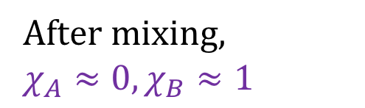


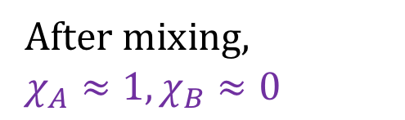
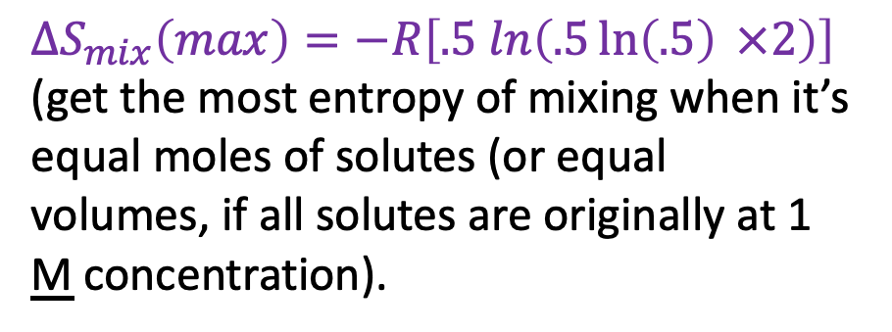
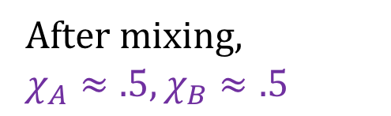

Entropy of mixing for varying volumes
1 L total; A and B both initially at 1 M concentration
A
B
A
B
A
B
After mixing,
$$χ_{A}≈0,χ_{B}≈1$$
After mixing,
$$χ_{A}≈.5,χ_{B}≈.5$$
After mixing,
$$χ_{A}≈1,χ_{B}≈0$$
$$∆S_{mix}\left(max\right)=−R\left[.5 ln\left(.5\ln\left(.5\right) ×2\right)\right]$$
(get the most entropy of mixing when it’s equal moles of solutes (or equal volumes, if all solutes are originally at 1 M concentration).
$${∆S}_{mix}$$
$$0$$
$$χ_{A}$$
$$1$$

Slide 18
Entropy of dilution and mixing in Python
Your task: do Week_11b.EntropyOfMixing

Slide 19
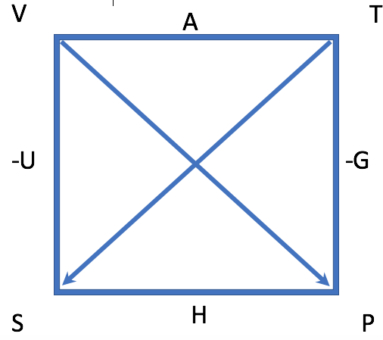
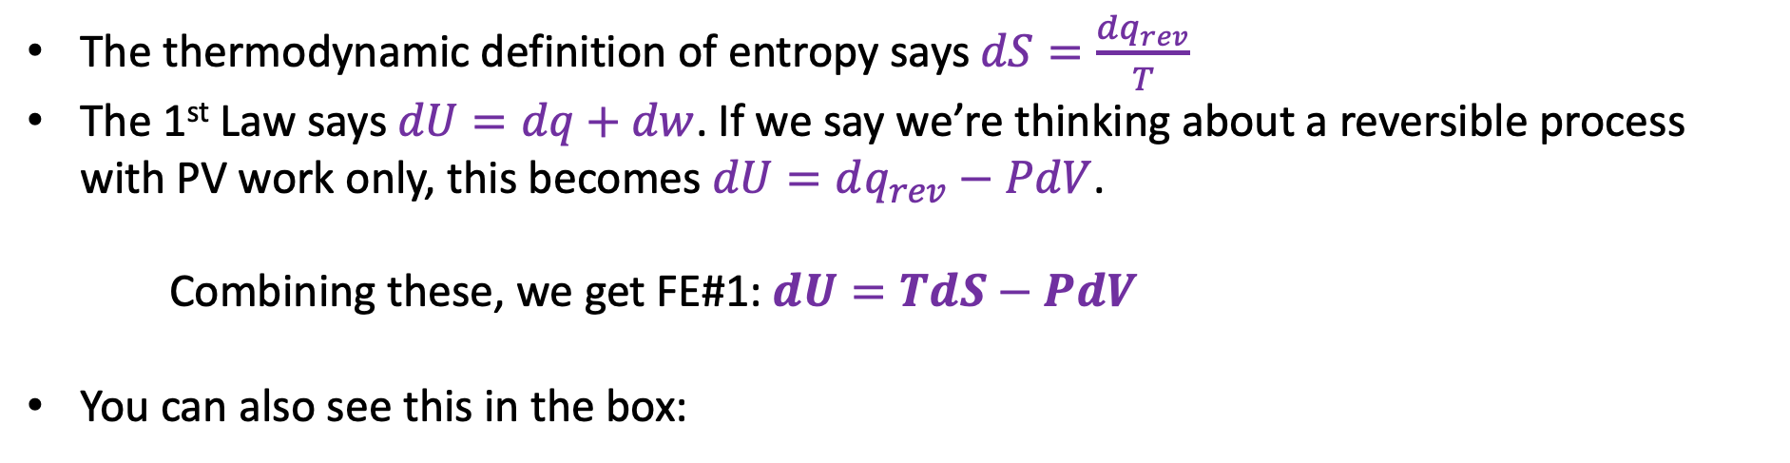
II. Four “Fundamental Equations” of Thermodynamics
The thermodynamic definition of entropy says $dS=\frac{dq_{rev}}{T}$
The 1st Law says $dU=dq+dw$. If we say we’re thinking about a reversible process with PV work only, this becomes $dU=dq_{rev}−PdV$.
Combining these, we get FE#1: $dU=TdS−PdV$
You can also see this in the box:

Slide 20
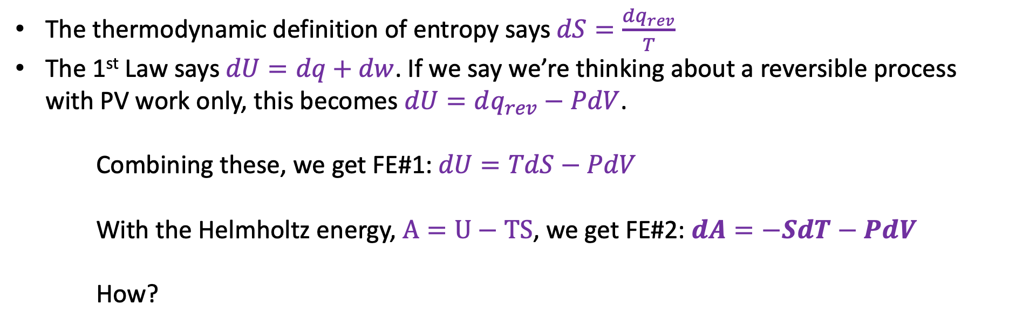
II. Four “Fundamental Equations” of Thermodynamics
The thermodynamic definition of entropy says $dS=\frac{dq_{rev}}{T}$
The 1st Law says $dU=dq+dw$. If we say we’re thinking about a reversible process with PV work only, this becomes $dU=dq_{rev}−PdV$.
Combining these, we get FE#1: $dU=TdS−PdV$
With the Helmholtz energy, $A=U−TS$, we get FE#2: $dA=−SdT−PdV$
How?

Slide 21
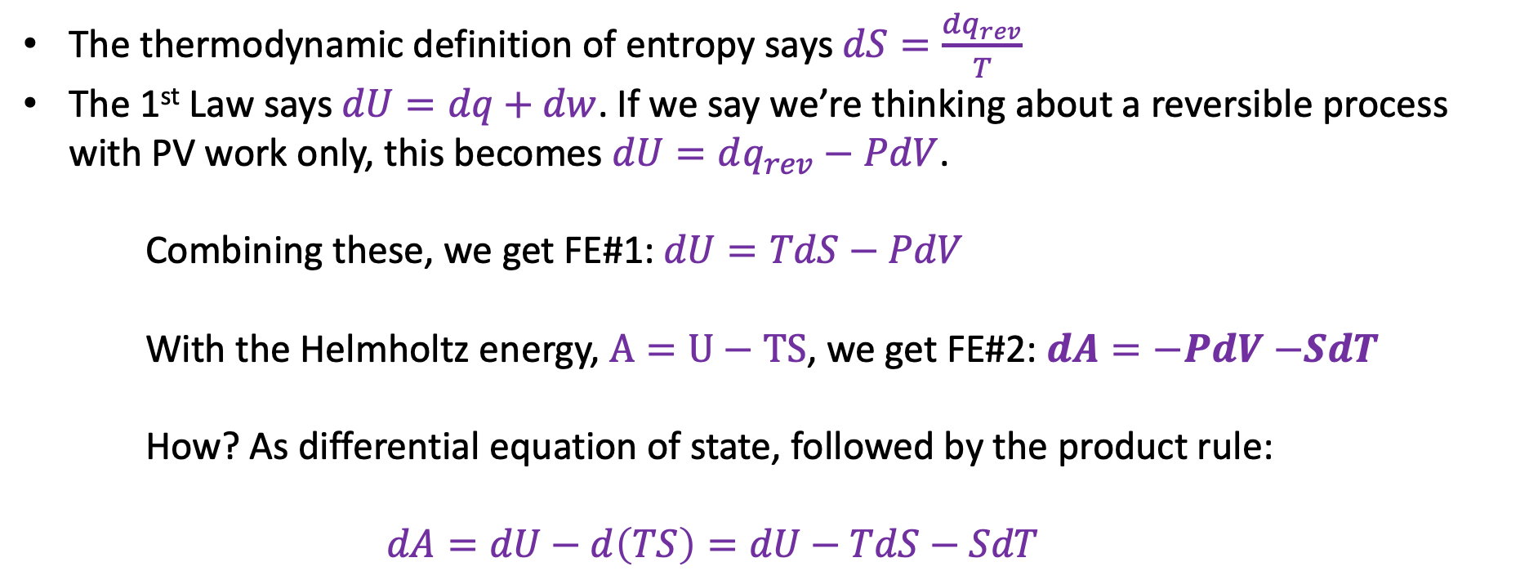
II. Four “Fundamental Equations” of Thermodynamics
The thermodynamic definition of entropy says $dS=\frac{dq_{rev}}{T}$
The 1st Law says $dU=dq+dw$. If we say we’re thinking about a reversible process with PV work only, this becomes $dU=dq_{rev}−PdV$.
Combining these, we get FE#1: $dU=TdS−PdV$
With the Helmholtz energy, $A=U−TS$, we get FE#2: $dA=−PdV$ $−SdT$
How? As differential equation of state, followed by the product rule:
$$dA=dU−d\left(TS\right)=dU−TdS−SdT$$

Slide 22
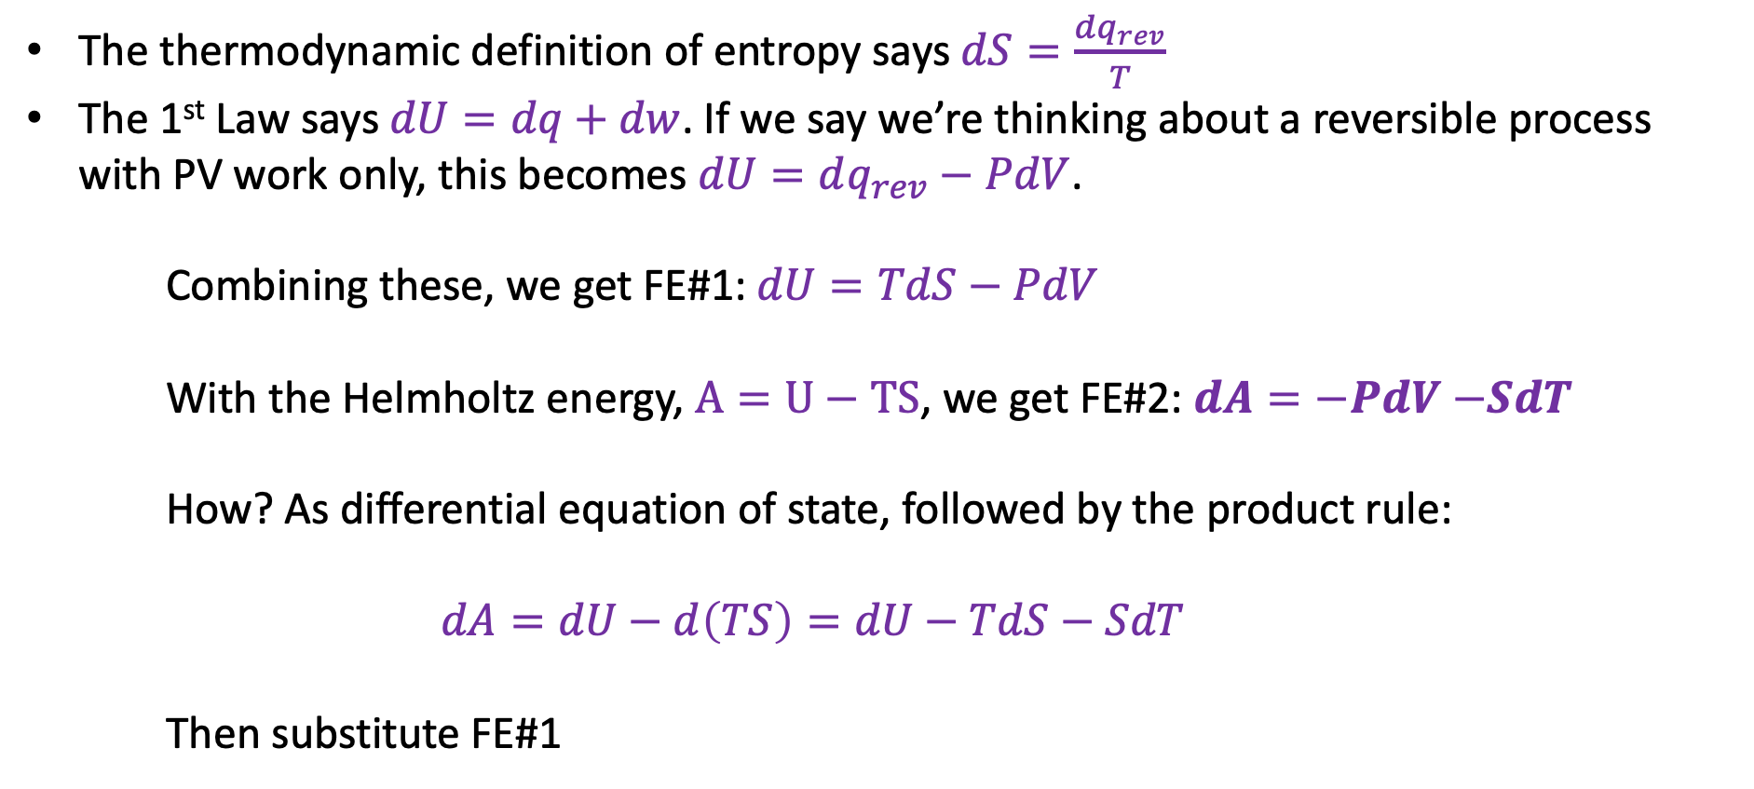
II. Four “Fundamental Equations” of Thermodynamics
The thermodynamic definition of entropy says $dS=\frac{dq_{rev}}{T}$
The 1st Law says $dU=dq+dw$. If we say we’re thinking about a reversible process with PV work only, this becomes $dU=dq_{rev}−PdV$.
Combining these, we get FE#1: $dU=TdS−PdV$
With the Helmholtz energy, $A=U−TS$, we get FE#2: $dA=−PdV$ $−SdT$
How? As differential equation of state, followed by the product rule:
$$dA=dU−d\left(TS\right)=dU−TdS−SdT$$
Then substitute FE#1

Slide 23
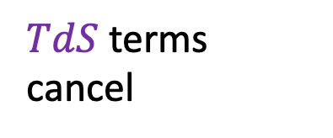
II. Four “Fundamental Equations” of Thermodynamics
The thermodynamic definition of entropy says $dS=\frac{dq_{rev}}{T}$
The 1st Law says $dU=dq+dw$. If we say we’re thinking about a reversible process with PV work only, this becomes $dU=dq_{rev}−PdV$.
Combining these, we get FE#1: $dU=TdS−PdV$
With the Helmholtz energy, $A=U−TS$, we get FE#2: $dA=−PdV$ $−SdT$
How? As differential equation of state, followed by the product rule:
$$dA=dU−d\left(TS\right)=dU−TdS−SdT$$
Then substitute FE#1
$TdS$ terms cancel

Slide 24
II. Four “Fundamental Equations” of Thermodynamics
The thermodynamic definition of entropy says $dS=\frac{dq_{rev}}{T}$
The 1st Law says $dU=dq+dw$. If we say we’re thinking about a reversible process with PV work only, this becomes $dU=dq_{rev}−PdV$.
Combining these, we get FE#1: $dU=TdS−PdV$
With the Helmholtz energy, $A=U−TS$, we get FE#2: $dA=−PdV$ $−SdT$
How? As differential equation of state, followed by the product rule:
$$dA=dU−d\left(TS\right)=dU−TdS−SdT$$
Then substitute FE#1
$TdS$ terms cancel

Slide 25
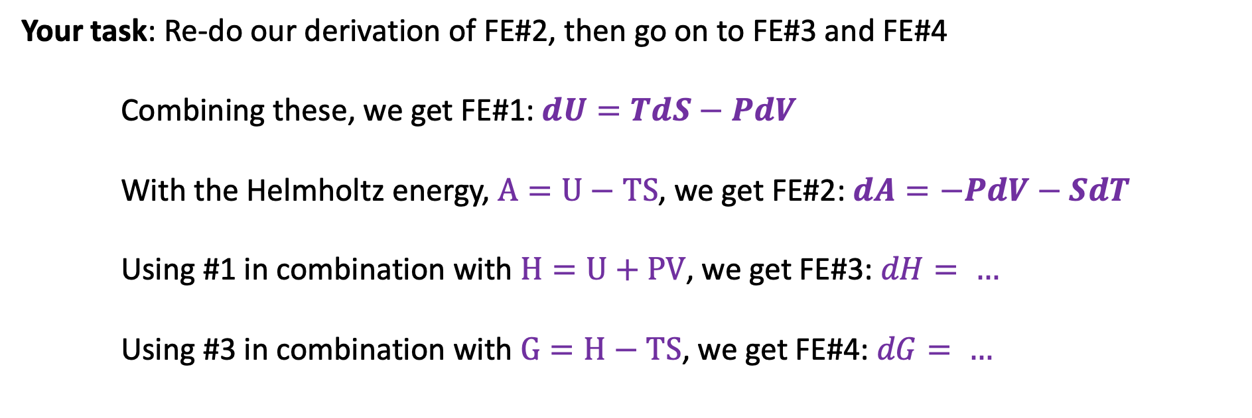
II. Four “Fundamental Equations” of Thermodynamics
Your task: Re-do our derivation of FE#2, then go on to FE#3 and FE#4
Combining these, we get FE#1: $dU=TdS−PdV$
With the Helmholtz energy, $A=U−TS$, we get FE#2: $dA=−PdV−SdT$
Using #1 in combination with $H=U+PV$, we get FE#3: $dH= …$
Using #3 in combination with $G=H−TS$, we get FE#4: $dG= …$

Slide 26
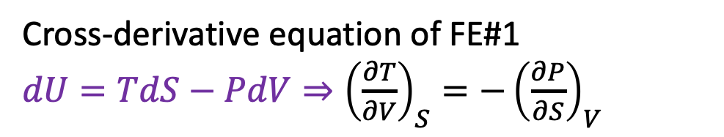
Cross-derivatives of the Fundamental Equations
Cross-derivative equation of FE#1
$dU=TdS−PdV⇒{\left(\frac{∂T}{∂V}\right)}_{S}=−{\left(\frac{∂P}{∂S}\right)}_{V}$

Slide 27
Cross-derivatives of the Fundamental Equations
Cross-derivative equation of FE#1
$dU=TdS−PdV⇒{\left(\frac{∂T}{∂V}\right)}_{S}=−{\left(\frac{∂P}{∂S}\right)}_{V}$
This agrees with the box!

Slide 28
Cross-derivatives of the Fundamental Equations
Cross-derivative equation of FE#1
$dU=TdS−PdV⇒{\left(\frac{∂T}{∂V}\right)}_{S}=−{\left(\frac{∂P}{∂S}\right)}_{V}$
This agrees with the box!
This is called a Maxwell Relation

Slide 29
Cross-derivatives of the Fundamental Equations
Cross-derivative equation of FE#1
$dU=TdS−PdV⇒{\left(\frac{∂T}{∂V}\right)}_{S}=−{\left(\frac{∂P}{∂S}\right)}_{V}$
This agrees with the box!
This is called a Maxwell Relation
Your task: Show that Maxwell Relations derived from cross-derivatives of FE#2 – FE#4 agree with the box

